Slide 1

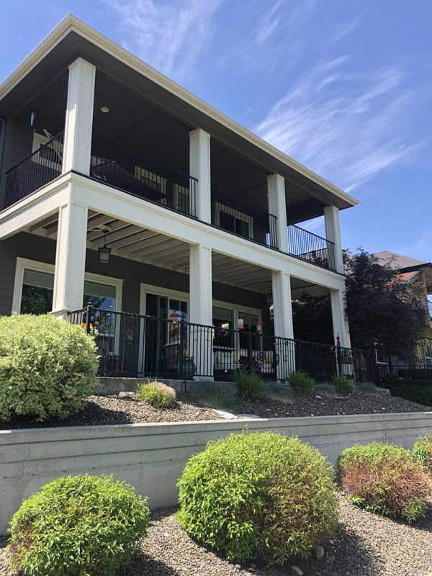
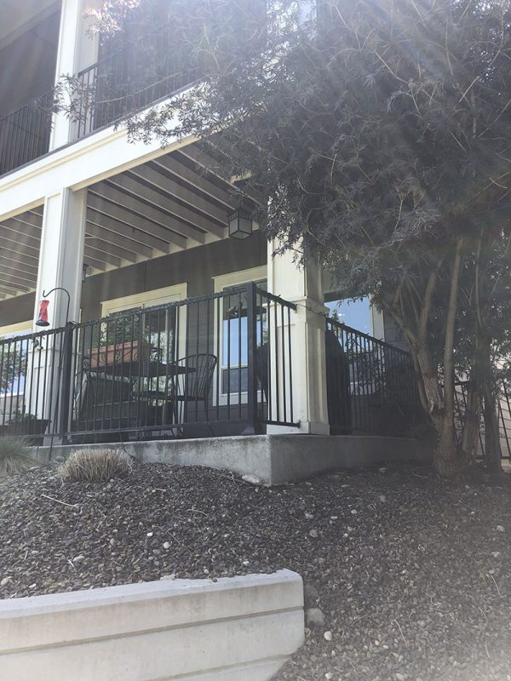
2 Story Back Patio
Garden City, Idaho • Concrete Lifting
PROBLEM
PROJECT PHOTOS
This is a new construction house built next to the green belt near the Boise River. The house needed to be built above the flood plane, so the contractor built a retaining wall and back filled it with road mix then compacted it in lifts as is common and correct practice. The contractor did a great job but over the course of a few years erosion and settlement happened and the 2-story deck area settled and caused separation and heaving in the panels on the covered back patio.
SOLUTION
During the initial inspection we probed the back filled area and found that there were voids at multiple different depths ranging from 2-5 feet deep. We recommended a 2 part structural foam to stabilization the unconsolidated soil. Once the deep injection was completed we lifted the back patio to the original grade and height. We also drilled weep holes through the retaining walls to allow the water trapped behind the wall to escape to allow for proper drainage.
two-story home and covered back patio (image 1)
RESULT
This particular project took another visit (under our warranty) the next year to re-inject one area and to relift some of the patio. Once lifted we sealed the control joints to prevent excess water intrusion in the covered patio. If water penetrates through the control/cut joints it will erode the sub-base and cause settlement. It’s now been stable since 2022 with no further treatments.
two-story home and covered back patio (image 2)
208-780-9292 • gopolyflow.com
POLYFLOW | CASE STUDY

