Slide 1

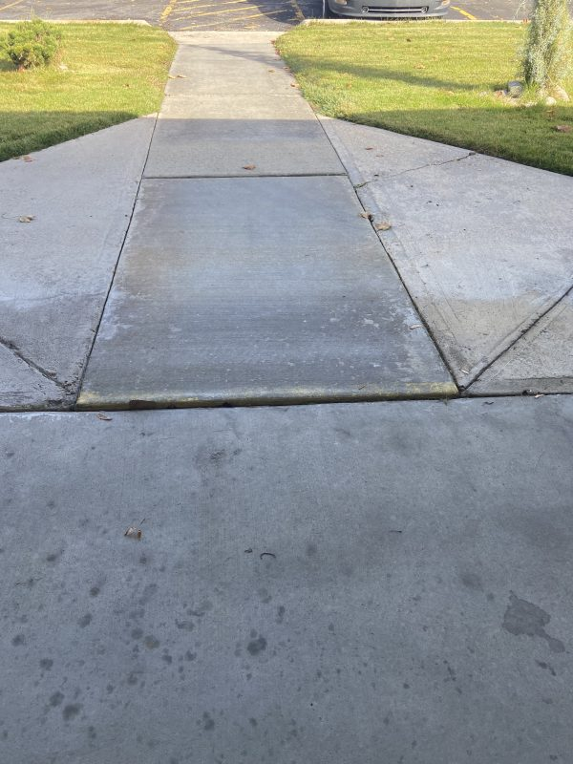
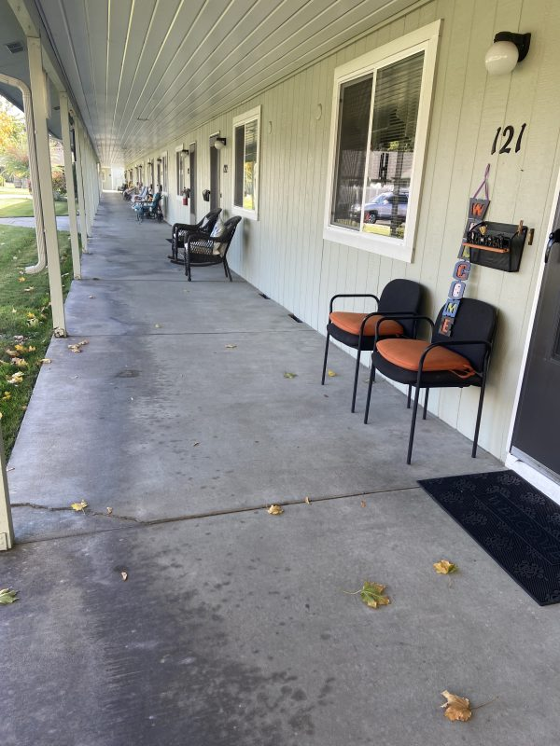
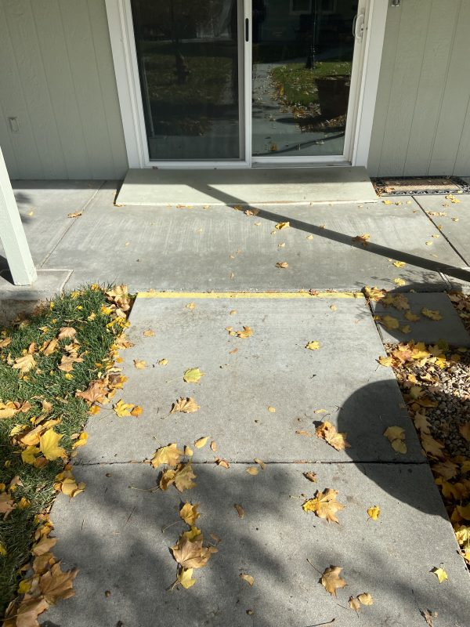
Apartment and Business Complex Risk Assessment
Treasure Valley, Idaho • Concrete Lifting
PROBLEM
PROJECT PHOTOS
Complexes often have sidewalks or walkways through out the property. Trip and slip hazards can not only be a risk for potential lawsuits but also higher insurance premiums. Insurance companies will often do onsite inspections to determine risk.
apartment-complex walkway hazard or color-coded assessment map (image 1)
SOLUTION
We work with property management teams to make effective remediation plans according to risk and maintenance budgets. We start with an onsite assessment and an overhead map of the complex. This color-coded map will show hazards ranked by severity. We start with resolving the highest risk issues first and then address future issues as part of an ongoing plan.
apartment-complex walkway hazard or color-coded assessment map (image 2)
RESULT
With a maintenance plan you can move forward with confidence knowing that you are reducing your liability.
apartment-complex walkway hazard or color-coded assessment map (image 3)
208-780-9292 • gopolyflow.com
POLYFLOW | CASE STUDY

