Slide 1

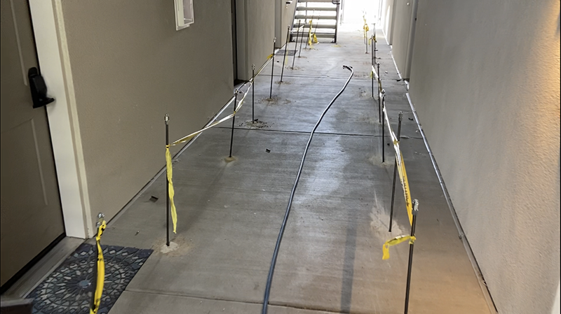
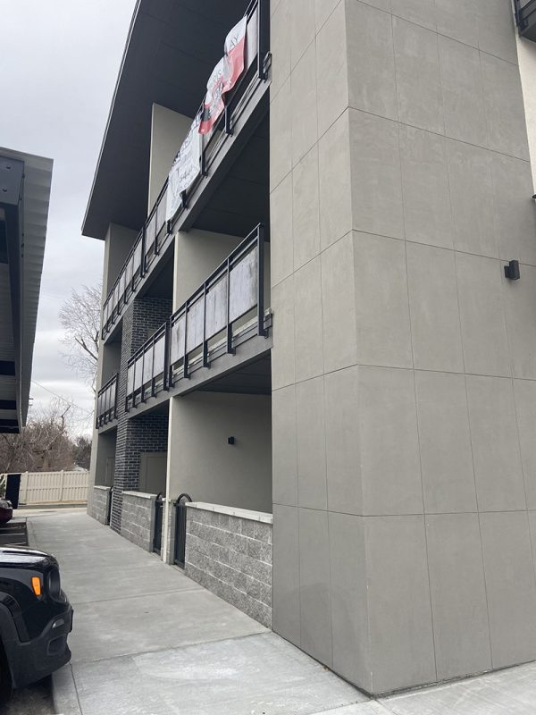
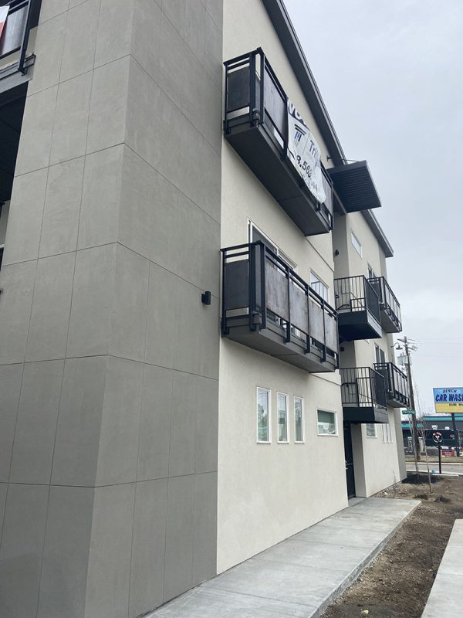
Apartment Foundation Repair
Boise, Idaho • Foundation Repair
PROBLEM
PROJECT PHOTOS
This project involved a three-story apartment complex. During the initial excavation phase of the construction process the compaction inspection was overlooked. The construction of the structure was completed; one year after the certificate of occupancy was given, the city noticed the missing compaction test. A geotechnical engineer was employed to test the load bearing capacity of the soil and found that it was rated at 1500 psf. The structural engineer specified 3000 psf for this specific project. The foundation soil needed to be brought up to the specification to insure the long-term structural integrity of the building.
apartment foundation, walkway, and site-plan assessment (image 1)
SOLUTION
We worked closely with the city as well as a local geotechnical engineer; who helped us design a plan that would increase the load bearing capacity of the soil and reduce the risk of settlement and the resulting property damage to the structure. The plan consisted of direct injection of a two-part structural foam into the soil under the footings. We drilled holes through the existing sidewalks and breezeways in order to install injection rods at predetermined depths and angles, this allowed us to inject the soils below the structure's footings where the soil improvements were needed. The local engineer pretested and post tested with a plate bearing test. He also post tested with an AMS Dynamic Cone Penetrometer. The results were above satisfactory.
apartment foundation, walkway, and site-plan assessment (image 2)
RESULT
We completed the project in two days and only during business hours. The impact on those who lived in the complex was minimal. None of the preexisting concrete needed to be removed and the existing landscape was minimally impacted.
apartment foundation, walkway, and site-plan assessment (image 3)
208-780-9292 • gopolyflow.com
POLYFLOW | CASE STUDY

