Slide 1

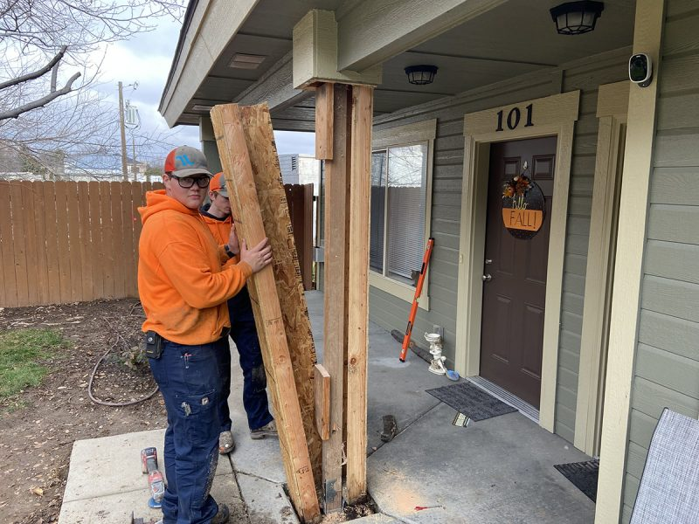
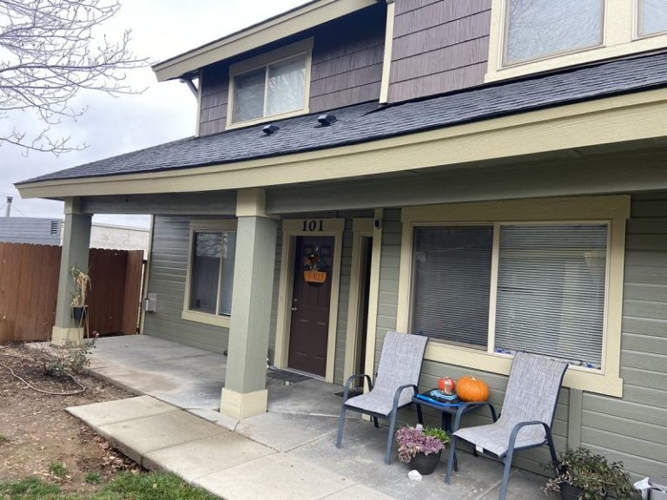
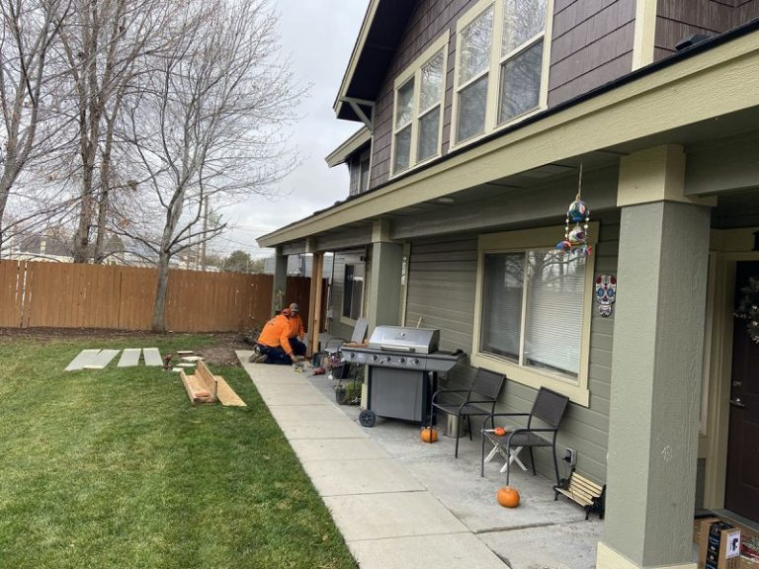
Apartment Pillar Lift
Meridian, Idaho • Foundation Repair
PROBLEM
PROJECT PHOTOS
These apartments have a common covered front porch that is supported by structural 4×4 wooden posts, which are surrounded by a decorative siding. Each individual post sits on a below-grade concrete sono-tube foundation. This particular post had settled nearly 4 inches. The roof structure had begun to detach from the main apartment building due to the settling structural post causing damaging weather to penetrate to the interior. The structural post needed to be repaired to prevent further property damage and potential liability issues.
apartment porch pillar and settled concrete repair area (image 1)
SOLUTION
First we removed the decorative siding to expose the 4×4 post. Next we mechanically lifted the post back to the proper height (nearly 4 inches). Once lifted we then secured the post with a 4×4 block and metal brackets. We then stabilized the loose inadequately consolidated soil with direct injection; utilizing a two-component structural foam. We drove injection rods deep under and around the concrete sono-tube footing and injected the soil to increase it's load bearing capacity. We also filled the identified voids under the porch and sidewalk. Once lifted and stabilized the decorative siding was reinstalled. We finished the project by pouring new concrete around the base with the new concrete grading away from the base of the structural post.
apartment porch pillar and settled concrete repair area (image 2)
RESULT
Aesthetically the roof line is at its original elevation but most importantly the roofing materials and structure line up to protect the interior from damaging rains and weather.
apartment porch pillar and settled concrete repair area (image 3)
208-780-9292 • gopolyflow.com
POLYFLOW | CASE STUDY

