Slide 1

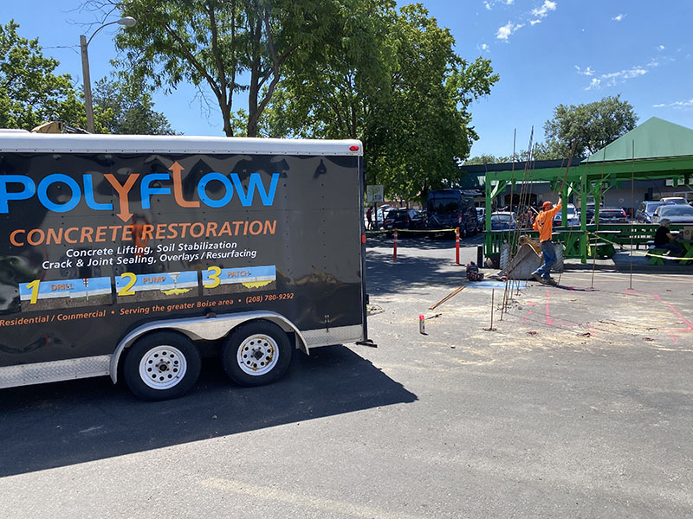
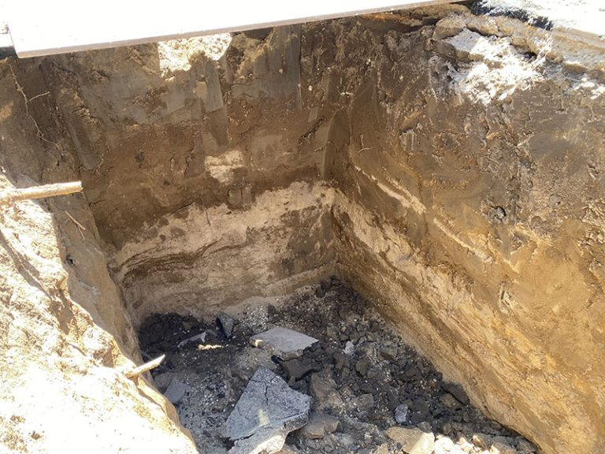
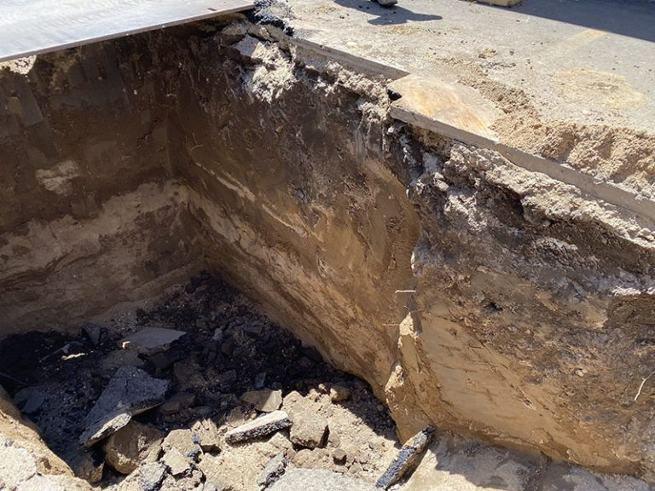
Boise COOP Single Component Shoring
Downtown Boise, Idaho • Soil Stabilization
PROBLEM
PROJECT PHOTOS
The Boise Coop needed a new tank installed in the parking lot. The parking lot has limited space and normally the excavation company would dig a very large hole so they can fit the safety shoring on the walls of the hole. The excavation company wanted the smallest impact on the parking lot so they called Polyflow.
parking-lot excavation shoring work (image 1)
SOLUTION
For chemical shoring we use a single component material that will penetrate into the soil and lock all of the particles of soil together so that the excavator can dig right next to it and the soil will maintain its form and not collapse. It's almost as if it changes into excavatable concrete. Sandy soils will become a solid mass that doesn’t slough.
parking-lot excavation shoring work (image 2)
RESULT
This process allowed the excavator to safely dig a hole just big enough to fit the tank in without compromising safety or soil integrity as well as expensive and time consuming shoring.
parking-lot excavation shoring work (image 3)
208-780-9292 • gopolyflow.com
POLYFLOW | CASE STUDY

