Slide 1

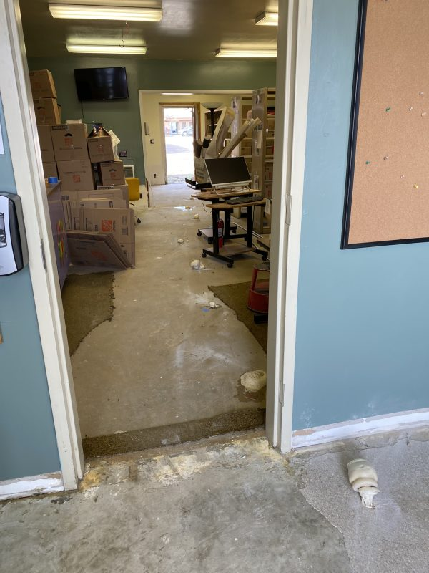
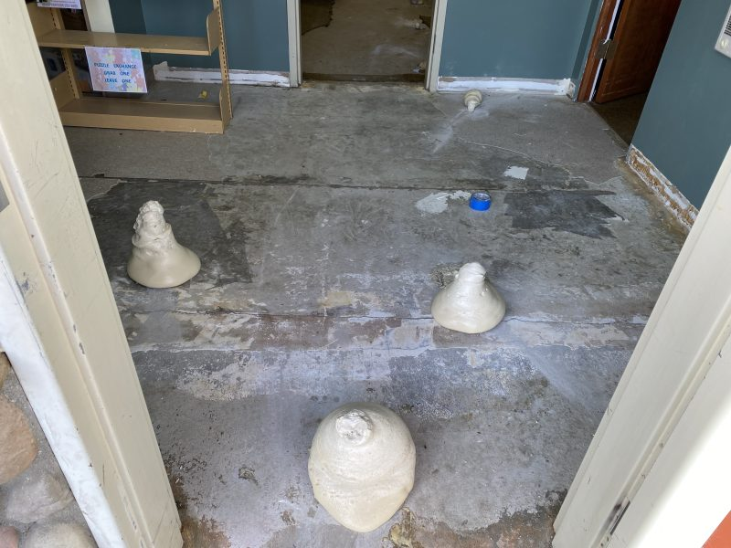
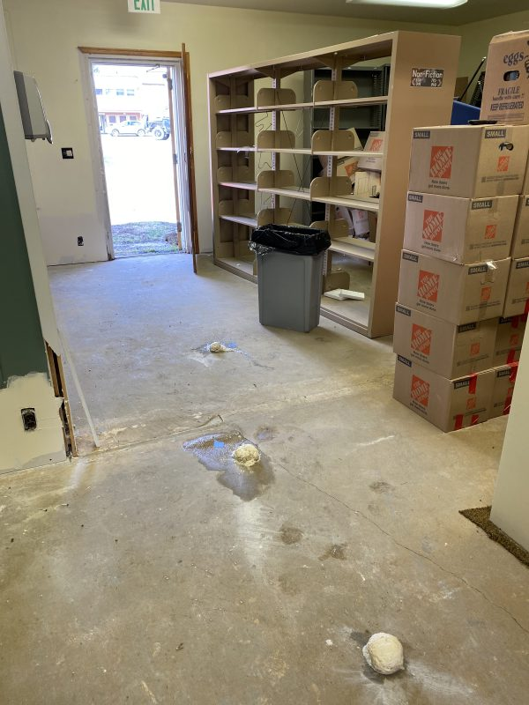
Cascade Library Slab on Grade Void Fill
Cascade, Idaho • Soil Stabilization
PROBLEM
PROJECT PHOTOS
The pharmacy in Cascade caught fire and when the fire department came to put it out water ran from the pharmacy downhill under the library causing a void under the concrete slab on grade.
SOLUTION
library interior slab with foam injection points (image 1)
After determining the area of void under the concrete we used a two-part structural foam to inject and fill the void and stabilize the concrete to make sure it stays strong.
RESULT
library interior slab with foam injection points (image 2)
The goal was not to lift the concrete but to fill the void. We use special measuring instruments to monitor pressure under the concrete during the void fill process so as to not lift the concrete but only to pressurize the voids.
library interior slab with foam injection points (image 3)
208-780-9292 • gopolyflow.com
POLYFLOW | CASE STUDY

