Slide 1

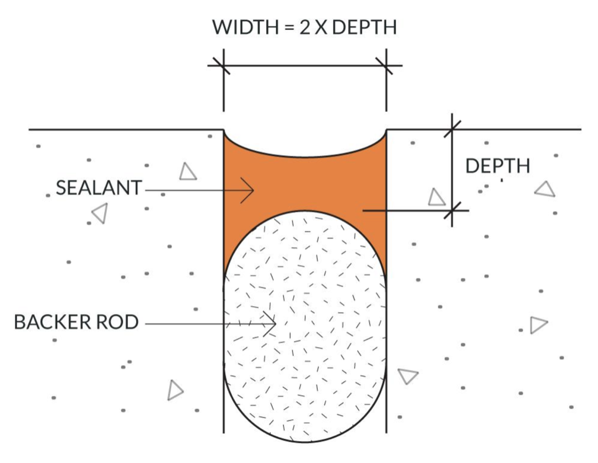
Common Joint Sealant
Meridian, Idaho • Concrete Lifting
PROBLEM
PROJECT PHOTOS
During wet weather water flows down driveways and sidewalks and into the control joints and under the concrete causing erosion leading to settlement of the concrete panels and often to cracking.
SOLUTION
We feel it is very important to install sealant per the manufacturers exact recommendations. Our process starts by cutting the joints clean or pressure washing to open pores of concrete and to remove debris, then we set backer rod to the correct depth so the sealant is the right profile and thickness, next we install a self leveling sealant, and finally we add UV protective sand to make the cracks and joints blend in with the concrete. The finished product looks like clean grout lines not rubber sealant.
RESULT
The completed joint sealant system helps prevent water from entering beneath the concrete, reducing the erosion that can lead to settlement, uneven panels, and cracking. Proper joint preparation, backer rod depth, and sealant thickness allow the joint to remain flexible as the concrete expands and contracts.
The finished joints are clean, durable, and designed to blend naturally with the surrounding concrete. In addition to improving the appearance of the driveway and sidewalks, the treatment provides long-term protection against water intrusion and helps extend the life of the concrete.
Common Joint Sealant
208-780-9292 • gopolyflow.com
POLYFLOW | CASE STUDY

