Slide 1

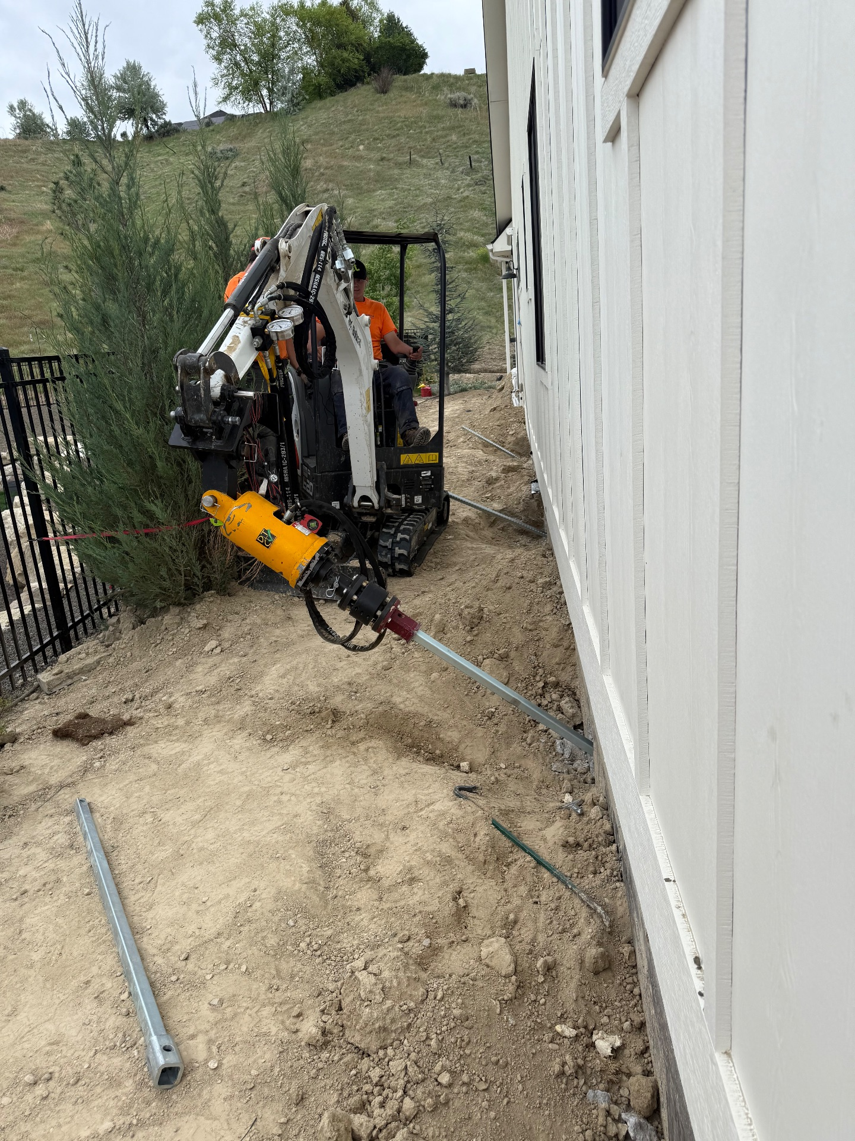
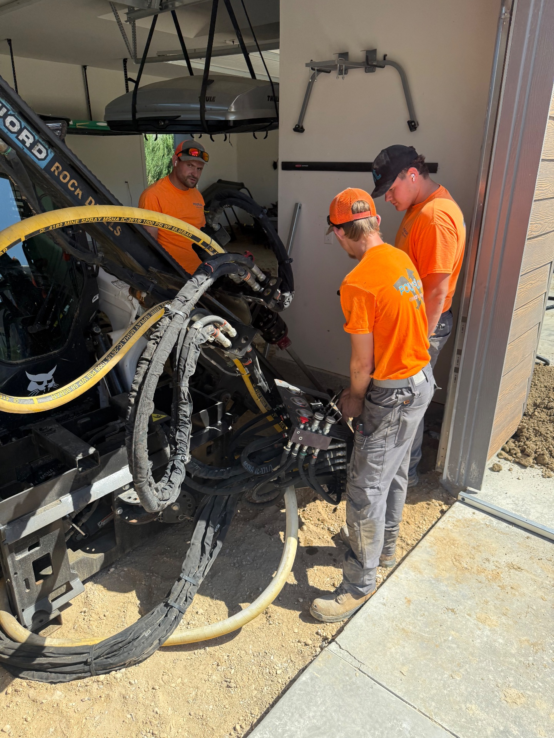
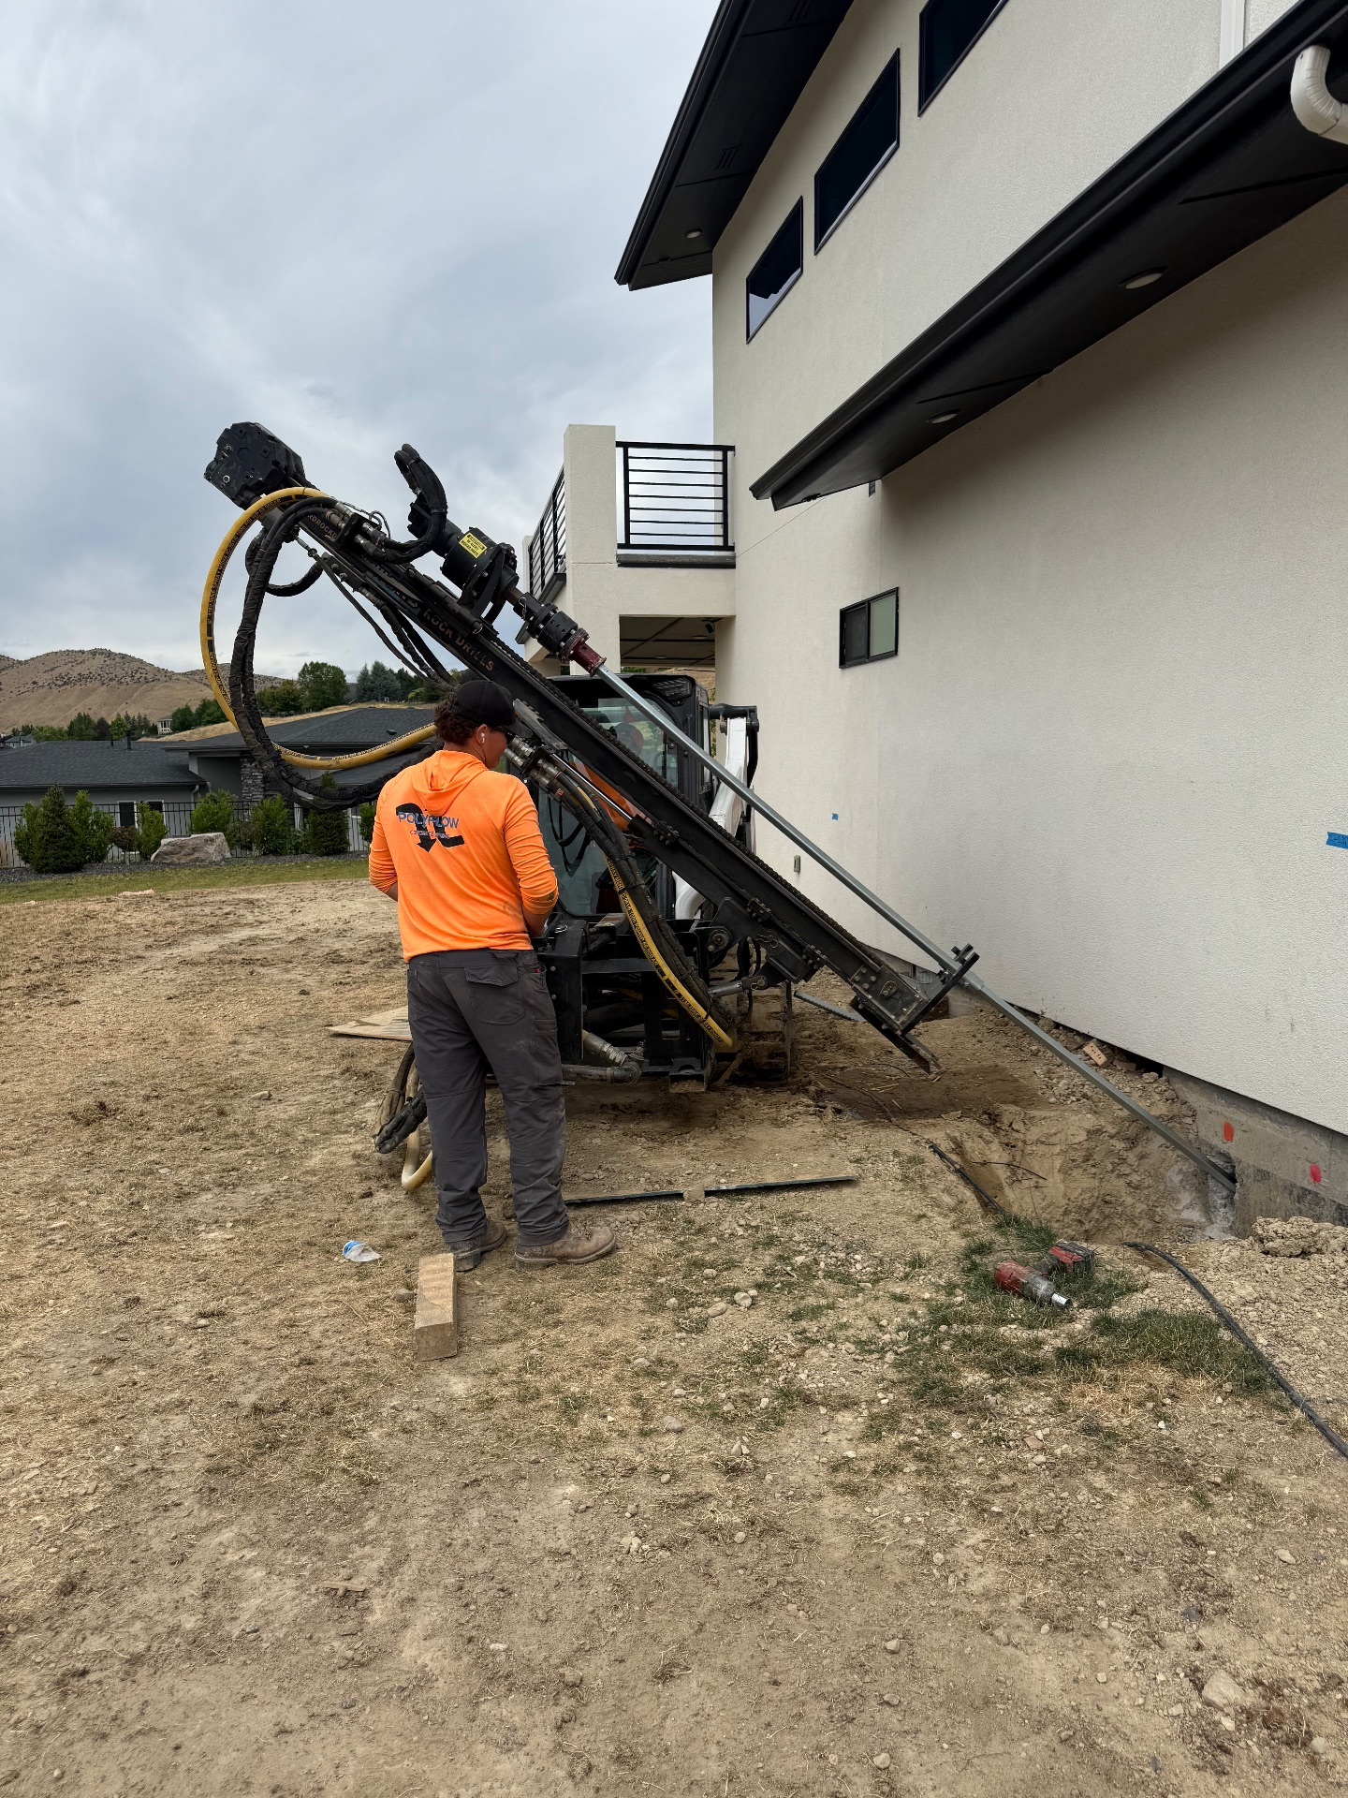
Complex Foundation Repairs
Boise Foothills, Idaho • Foundation Repair
PROBLEM
PROJECT PHOTOS
A newly developed neighborhood was built on 12 feet to 35 feet of fill material. Over the course of the first few years homeowners experienced differential foundation settlement from 6 inches to 14.5 inches. The settlement caused doors and windows to stick drywall to crack and damage to exterior trims and roofing. Other issues included broken irrigation pipes, disconnected storm drainage systems and broken pool plumbing. In addition to settlement homes also experienced lateral movement.
SOLUTION
Installing helical tiebacks with a mini excavator
Most foundation repair companies don't have a solution for house foundations that have settled 14.5 inches and that have moved laterally. Working with geotechnical engineers and structural engineers we were able to provide solutions that used push piers, helical piers and helical tiebacks as well as crawl space screw jacks systems. We have lifted 10 of the houses in this neighborhood. Once lifted we repair all of the storm drainage and we’ve even installed french drains for ground water collection. Then we bring in our subcontractors to repair drywall & interior paint, concrete replacement, landscape, garage door repair and other handyman services like interior door adjustments and trim work.
Installing helical tiebacks with our drill rig.
RESULT
During such a stressful time for the homeowners Polyflow cared. We did our very best to go above and beyond making this experience as pleasant as possible. In the weeks and months following our services we never hesitated to make necessary adjustments to the screw jacks in the crawl space or door adjustments or whatever we needed to do to make sure we kept up with the issue of the fill soil continuing to consolidate throughout the neighborhood. Homeowners now get to enjoy a level home although the challenges in the soil are on going.
Installing helical tiebacks with our drill rig.
208-780-9292 • gopolyflow.com
POLYFLOW | CASE STUDY

