Slide 1

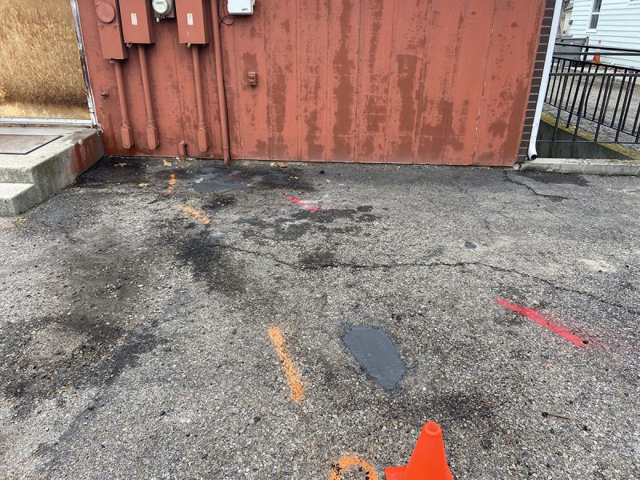
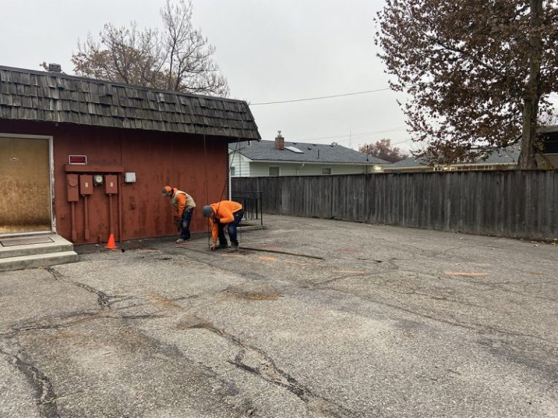
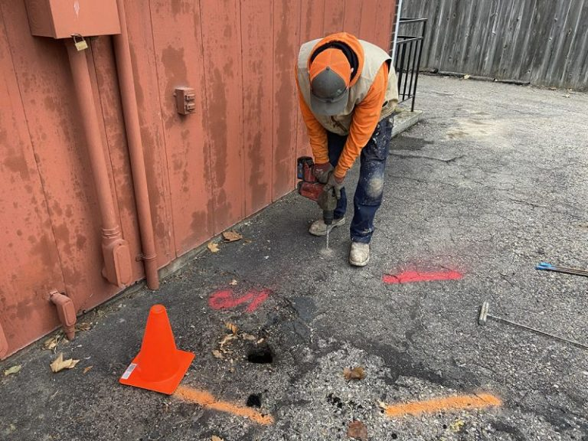
Fixing a Sink Hole in a Parking Lot
Caldwell, Idaho • Soil Stabilization
PROBLEM
PROJECT PHOTOS
There were a few small surface holes in the asphalt in a parking lot. Upon further inspection we found that some of the holes were up to 21 feet deep. The area was closed off to prevent vehicles from entering the area of concern.
SOLUTION
parking-lot sinkhole inspection and injection layout (image 1)
There was power, communication and sewer in the area so we had location services come and mark all of the utilities. We placed our injection tubes up to 20 feet deep with our proprietary deep injection system. The first visit we had a total of 8 injections and we installed a large amount of material to fill and stabilize the void. After this initial visit we got another call from the property owner with a new area and a new hole for us to come and to remediate.
parking-lot sinkhole inspection and injection layout (image 2)
RESULT
After two visits the area is now stable and the parking lot has been restored to normal use.
parking-lot sinkhole inspection and injection layout (image 3)
208-780-9292 • gopolyflow.com
POLYFLOW | CASE STUDY

