Slide 1

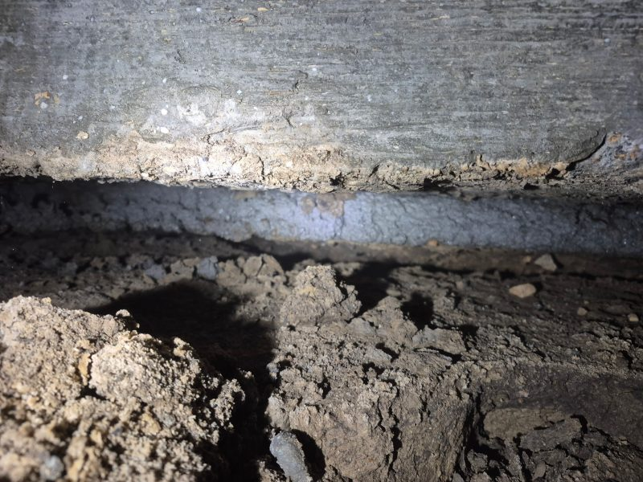
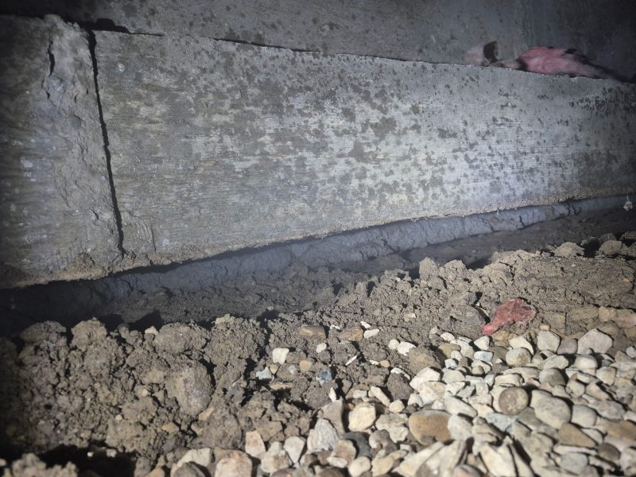
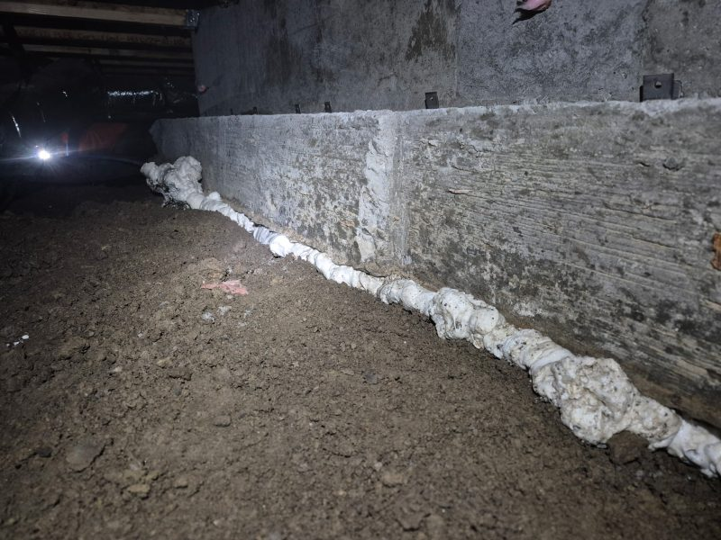
Flowable Grout vs High Density Structural Foam
Treasure Valley, Idaho • Foundation Repair
PROBLEM
PROJECT PHOTOS
In foundation lifting projects using helical or push piers, a void often remains between the footing and the ground after elevation is restored. If that gap is not properly filled, it becomes a weakness that can invite rodents and insects and create a path for moisture intrusion. We often see flowable grout specified for this step, but in practice it frequently does not reach fully beneath the footing, leaving large areas unsupported.
crawl-space footing void filled with structural foam (image 1)
SOLUTION
From inside the crawl space, we inject high-density structural lifting foam so it expands to fill every void and contact the footing from edge to edge. The foam forms a continuous gasket from the exterior edge of the footing to the interior edge, creating both support and a tight seal.
crawl-space footing void filled with structural foam (image 2)
RESULT
The footing receives continuous, uniform support, and the sealed interface helps keep pests and moisture out. The result is a cleaner, more complete finish to a foundation lift.
crawl-space footing void filled with structural foam (image 3)
208-780-9292 • gopolyflow.com
POLYFLOW | CASE STUDY

