Slide 1

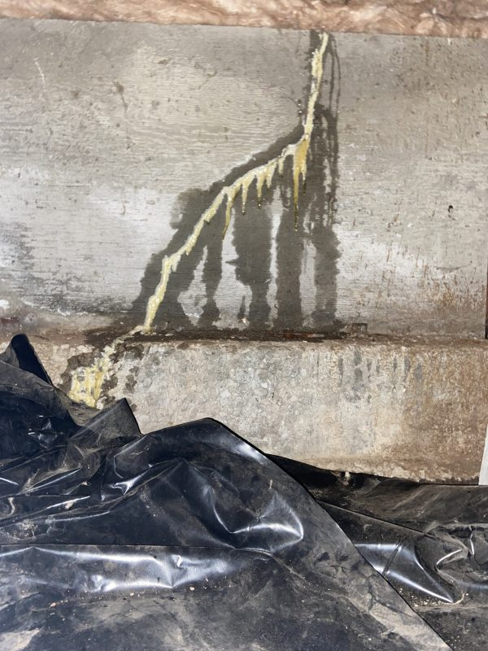
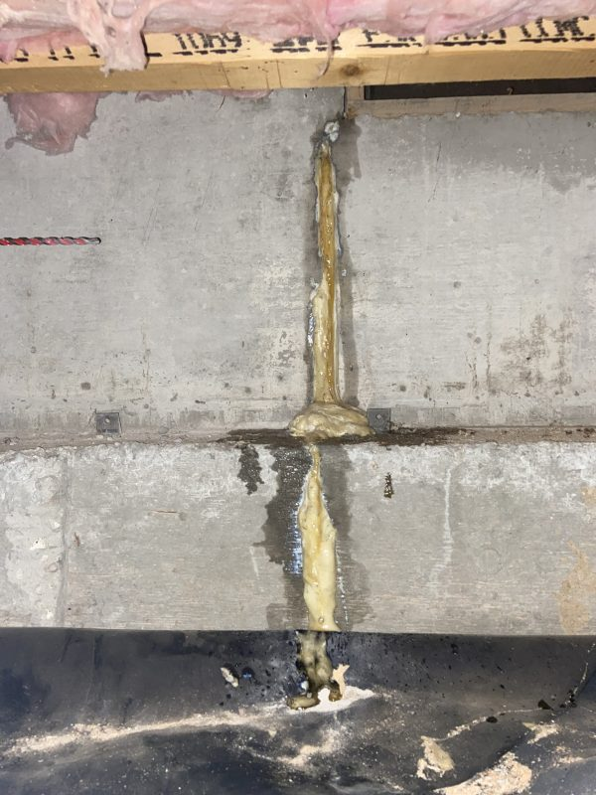
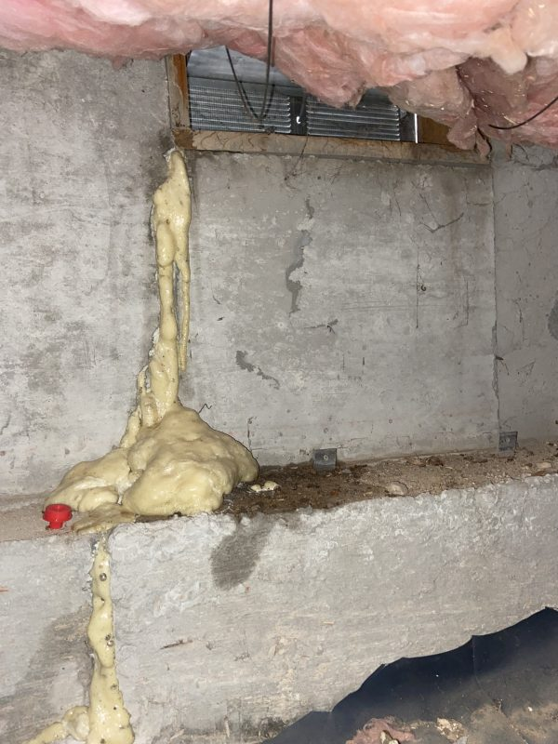
Foundation Crawl Space and Basement Crack Seal
Boise, Idaho • Crack and Joint Sealing
PROBLEM
PROJECT PHOTOS
Most stem walls/foundations or basements have cracks in them. You don't always need to be concerned with the cracks but if water is penetrating through them it can cause mold, water damage and other issues and should be addressed.
SOLUTION
We seal these cracks from inside the crawl space with a permanent pressure grout system. Water activated grout is injected under pressure from inside and penetrates all the way through to the outside sealing out water permanently with a flexible waterproof grout.
Some contractors will use a nonsag sealant to seal these cracks. Nonsag sealers often fail quickly. They are not designed for this type of application.
During the grouting process we take a lot of pictures so that homeowners can see the process and results without the need to go into the crawl space.
foundation crack-seal and exterior drain area (image 1)
foundation crack-seal and exterior drain area (image 2)
RESULT
Pressure grouting cracks in foundation walls is the long term permanent solution.
foundation crack-seal and exterior drain area (image 3)
208-780-9292 • gopolyflow.com
POLYFLOW | CASE STUDY

