Slide 1

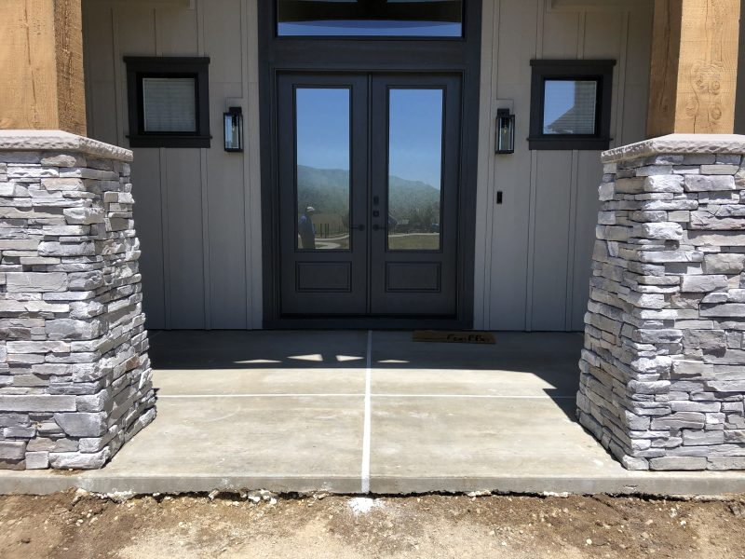
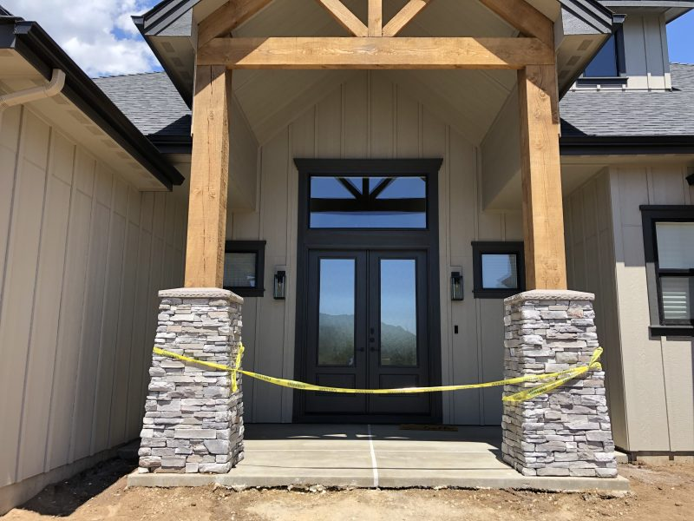
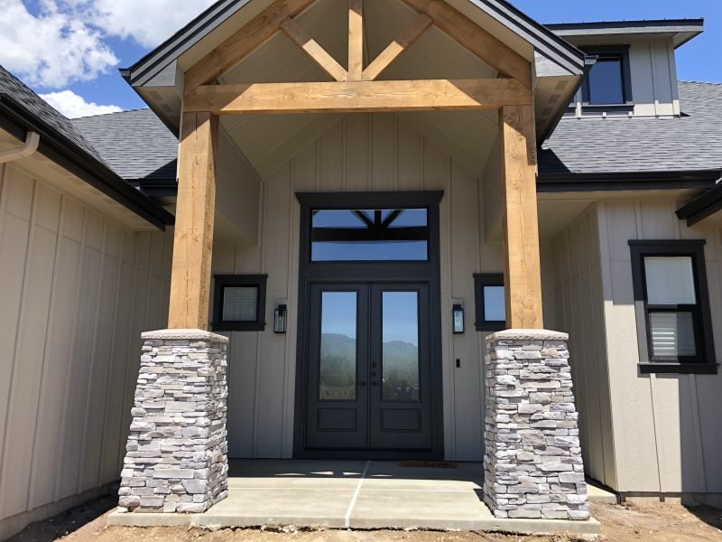
Front Porch Pillars
Idaho City, Idaho • Foundation Repair
PROBLEM
PROJECT PHOTOS
During the initial concrete foundation construction phase the concrete contractor installed the sub-grade support piers 3 feet below the level they should have been installed. The ground level was brought up with road mix and compacted up to grade under the above grade roof support pillars and the 4 inch concrete flatwork leading to the front entry way. During our pre inspection we used a probe to detect voids between the slab on grade and the concrete pillar 3 feet below grade. We also measured both pillars which had settled 1 inch lower than the original grade. The pillars settling on the front side of the porch caused the front porch pad to heave in the middle causing a trip hazard across the middle of the entire entry way.
front porch pillars and concrete-entry work (image 1)
SOLUTION
With our direct injection process we locked the unconsolidated base material between the original sub-grade concrete pillar 3 feet below the surface and the slab on grade above grade support pillars with a two-component structural foam; this process increased the load bearing capacity of the soil to allow us to lift to proper grade. Then we drilled small holes through the surface of the front porch slab and lifted the slab and pillars to their original grade and height; this caused the heaved slab in the middle to lower back down into it's original position which eliminated the trip hazard. This process created a consolidated mass of soil between the top of the concrete pillar below grade and the on-grade concrete porch. The above grade roof structure and porch now efficiently transfers it's weight to the below grade concrete pillars; creating a permanent solution to a structural problem with minimal disruption to the existing surrounding area.
front porch pillars and concrete-entry work (image 2)
RESULT
The pillars are now sitting on a high density structural foam footing. The front was lifted and there is no trip hazard or fear of the pillars sinking into the ground.
6 year UPDATE Still no settlement!!
front porch pillars and concrete-entry work (image 3)
208-780-9292 • gopolyflow.com
POLYFLOW | CASE STUDY

