Slide 1

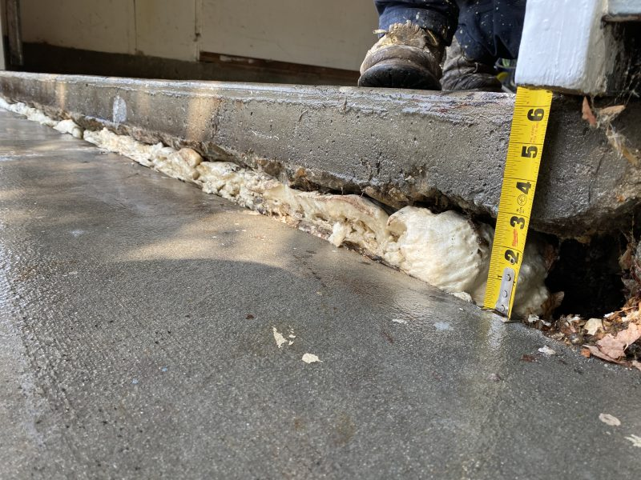
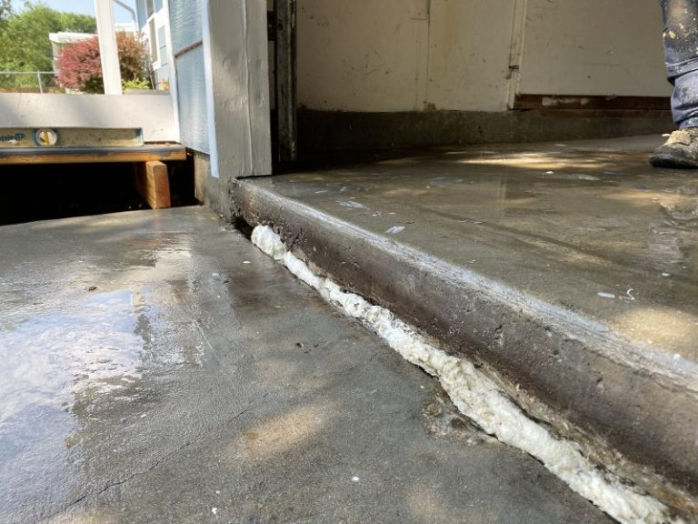
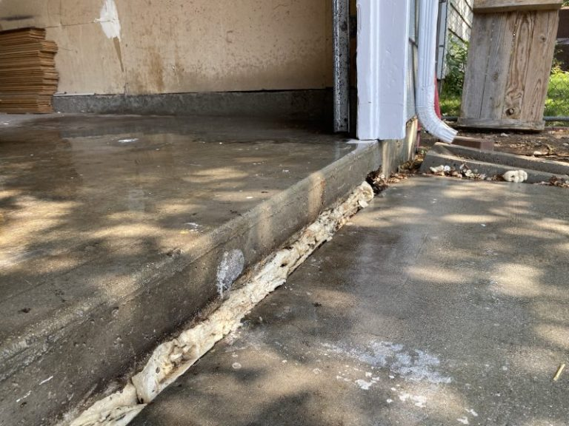
Garage Floor and 6" Driveway Lift
Boise, Idaho • Concrete Lifting
PROBLEM
PROJECT PHOTOS
Both the garage floor as well as the driveway settled more than 6 inches causing an extreme trip hazard and a major inconvenience for access into the garage. Not only did the garage floor settle but there was a large void under it that needed to be filled as well.
SOLUTION
The first part of the process was to fill the void under the garage floor and then to begin lifting the garage floor back to its original height. This large void under the garage floor took a lot of material to fill. Any voided area under a concrete slab can cause damage or settling in the future. Once the garage floor was lifted into place, we could then slowly and systematically lift the driveway. Inexperienced concrete lifters can lift too much or to fast in one injection site causing undo stress on the concrete which may lead to stress cracking. This slow lift process is a critical part of our lifting system. There is always a chance that concrete can crack but we have proven systems for preventing cracking as much as possible. The garage floor and driveway is back to its original grade and height.
settled garage floor and driveway slab edge (image 1)
settled garage floor and driveway slab edge (image 2)
RESULT
This project went as smoothly as it could have gone, in fact, we had an audience from the neighbors during the whole visit. When we were finished one of the neighbors had us come to his house immediately afterwards to do the same thing to his garage floor and driveway. We love to be able to serve neighbors on the same day while we are there.
settled garage floor and driveway slab edge (image 3)
208-780-9292 • gopolyflow.com
POLYFLOW | CASE STUDY

