Slide 1

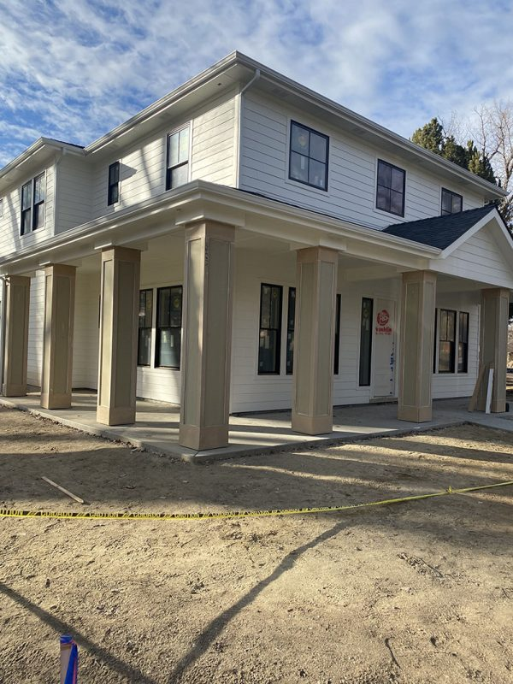
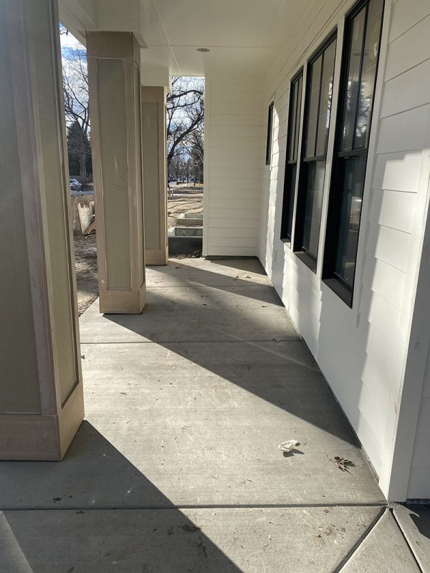
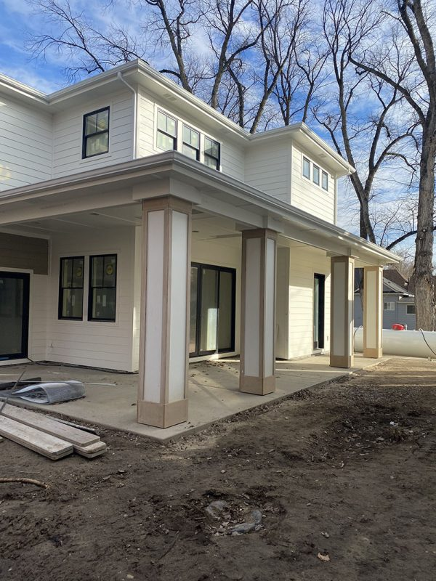
Lack of Compaction New Construction Front Porch
Eagle and Downtown Boise, Idaho • Soil Stabilization
PROBLEM
PROJECT PHOTOS
Two projects—one in Eagle and one in Downtown Boise—had the same deep-soil issue after excavation contractors backfilled against new foundations without compacting in lifts. One porch settled before construction was complete; the other settled and cracked. One contractor removed the concrete before Polyflow arrived; the other left it in place. Earlier intervention might have saved the removed porch. Both projects remediated the lack of compaction.
Two-story house with unfinished front porch and columns
SOLUTION
Steel tubes reached native soil at about 4–5 feet on one job and about 9 feet on the other. Two-part structural foam was injected at 4-foot spacing to consolidate loose soil. High density structural grade foam expands 22-24 times its liquid state filling any voids, lenses, and fissures causing the compromised soil to permanently increase its load bearing capacity.
Covered front-porch walkway beside house columns
RESULT
Deep soil was compacted without costly excavation and concrete demo. New concrete was poured over stable soil at the removed-porch site. At the intact porch, angled rods treated soil beneath the slab while monitoring unwanted lift. This avoided removing and replacing all the soil next to the foundation and then compacting in lifts around pillars and existing structures, which is a huge cost and time savings to the contractor/client.
Two-story house with front porch and ungraded work area
208-780-9292 • gopolyflow.com
POLYFLOW | CASE STUDY

