Slide 1

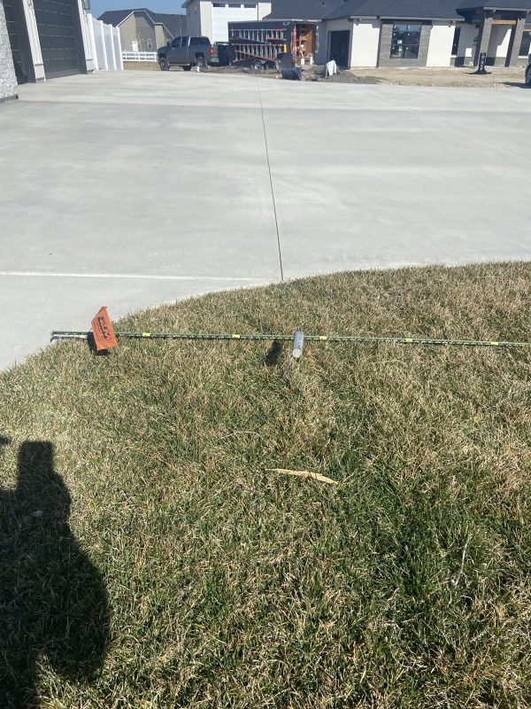
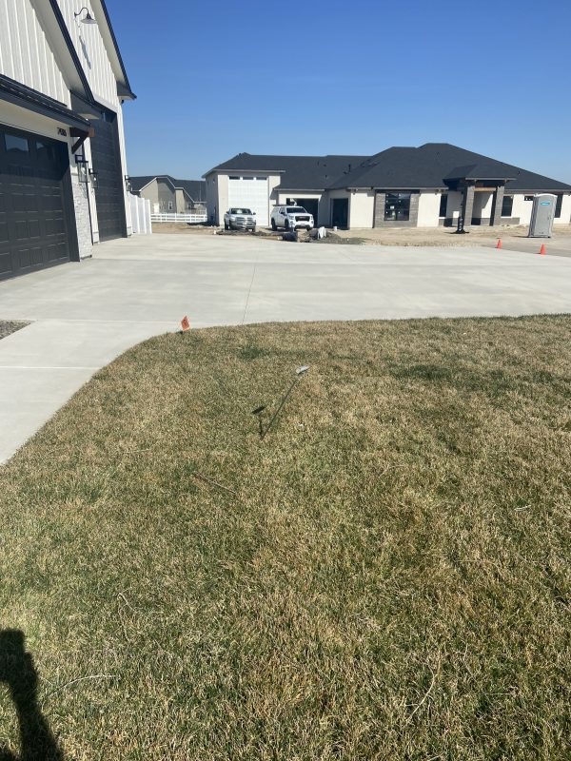
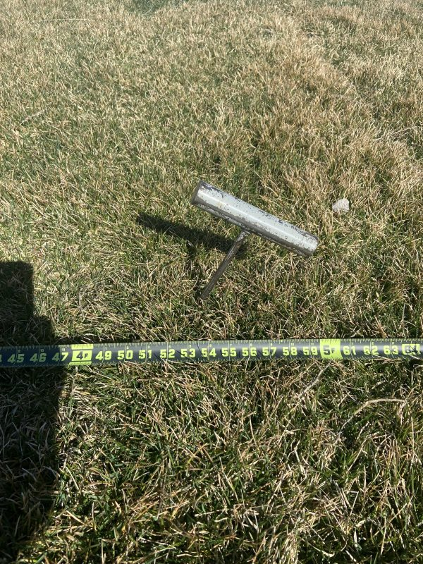
Residential Compaction Testing with a Handheld Probe
Treasure Valley, Idaho • Soil Stabilization
PROBLEM
PROJECT PHOTOS
Many concrete leveling quotes are based on a quick visual inspection, a few measurements, and assumptions about the cause. In reality, settlement can be driven by deep soil issues, erosion, or sub-base failure, and the right fix depends on identifying the true cause.
SOLUTION
residential concrete and handheld-probe inspection (image 1)
We use a handheld steel probe, fabricated in our shop, to test below the surface and determine whether the problem is deep lack of compaction or erosion, or shallow sub-base settlement. Once we understand what is happening beneath the slab, we can recommend a solution designed for long-term performance, whether that means deep injection, void fill, or straightforward lifting.
residential concrete and handheld-probe inspection (image 2)
RESULT
Homeowners and builders receive a more accurate diagnosis and a solution matched to the real cause of movement. This improves outcomes, reduces callbacks, and supports the Polyflow standard of doing the job right.
residential concrete and handheld-probe inspection (image 3)
208-780-9292 • gopolyflow.com
POLYFLOW | CASE STUDY

