Slide 1

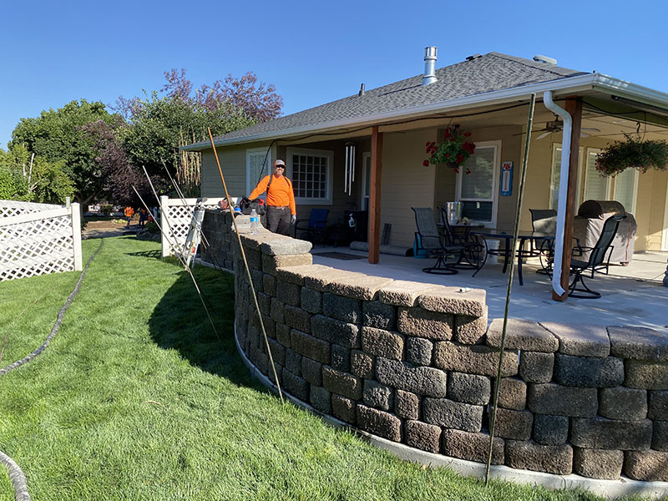
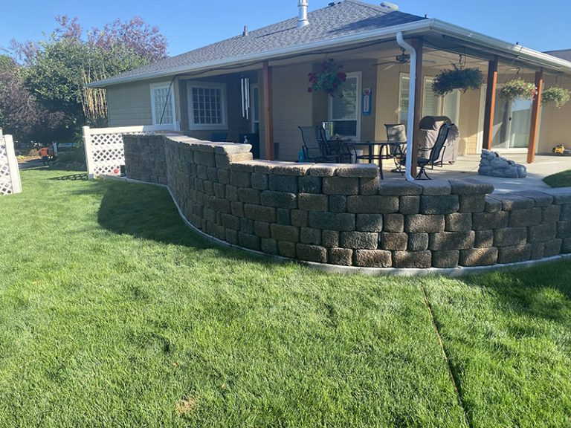
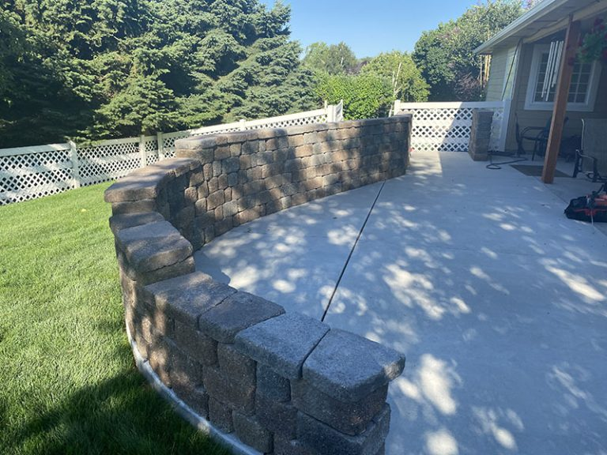
Retaining Wall Foundation
Nampa, Idaho • Concrete Lifting
PROBLEM
PROJECT PHOTOS
The homeowner built a retaining wall on the edge of their patio for privacy but the weight of the retaining wall caused the patio to settle on the outside and it caused the same slab to heave on the inside causing a trip hazard in the walking area. All of the joints in the patio were open and had not been sealed, this resulted in surface water flowing down through all of the joints in the patio in an uncontrolled manner; which over time contributed to deterioration of the sub-base material and settling of the concrete patio panels.
SOLUTION
retaining wall, patio, and injection work (image 1)
This is a situation where we recommended direct injection to create a structural foam foundation in the soil below the outside edge of the patio in order to increase the existing soils load bearing capacity so that it would support the added weight of the retaining wall. We spaced out our injections and drove our rods into the soil until we reached adequately compacted soil. We then performed direct injection of structural foam into the soil to a point of full saturation; at which point the soil began to expand upward until the outside edge of the patio with the retaining wall on top of it was lifted to the desired height in order to correct the settling that had occurred. Once the outside edge of the patio and retaining wall were restored to their proper height, the opposite corner of the patio panel which had created a tripping hazard settled back down to its proper height, this removed the existing tripping hazard on the clients patio.
retaining wall, patio, and injection work (image 2)
RESULT
Finally, after all the stabilizing and lifting was completed, we pressure washed and sealed the joints, this will greatly reduce surface water intrusion, and help to prevent any future degradation of the sub-base material supporting the concrete patio. There was zero impact on the landscape and the project was finished in a single morning. Now the homeowners can enjoy privacy that the wall provides with the weight of the wall not causing trip hazards and settlement issues on the patio.
retaining wall, patio, and injection work (image 3)
208-780-9292 • gopolyflow.com
POLYFLOW | CASE STUDY

