Slide 1

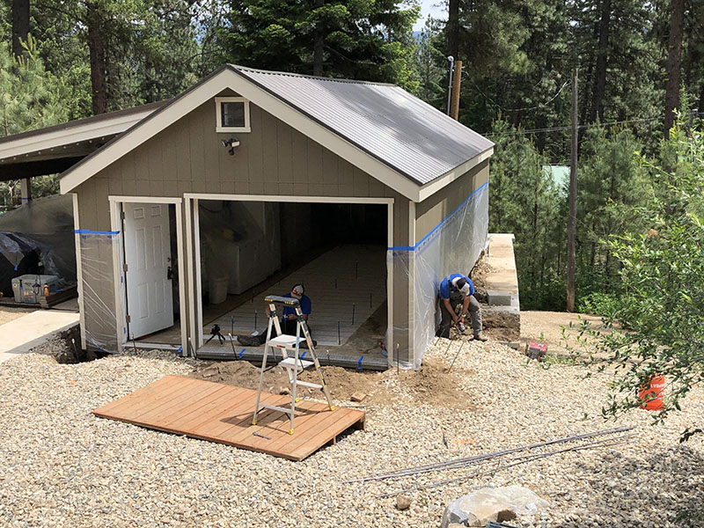
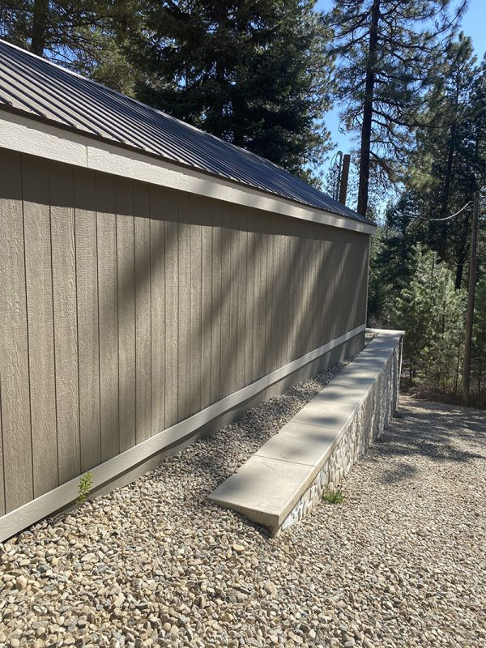
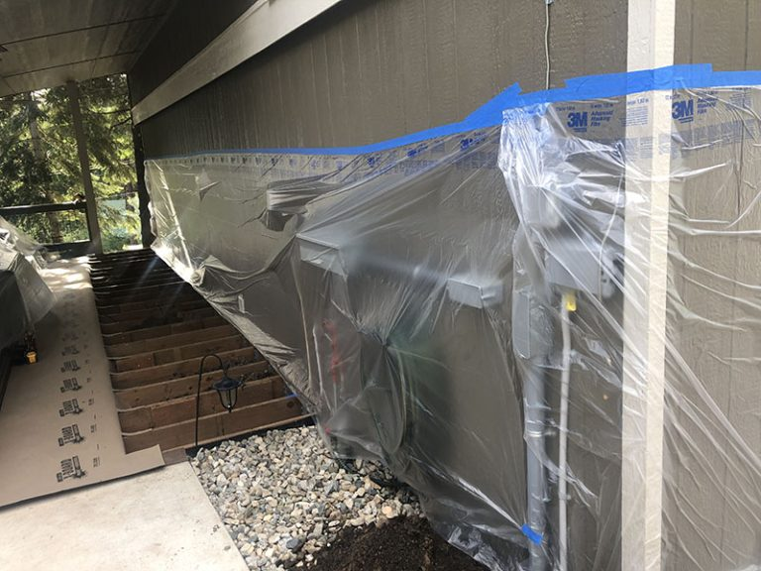
Shed Soil Stabilization
Garden Valley, Idaho • Soil Stabilization
PROBLEM
PROJECT PHOTOS
On this mountainous property, a 16W × 32L shed was backfilled around large cement barrier blocks with native soil containing organic and other deleterious material; it was not placed in compacted lifts. The shed settled more than 18 inches, damaging its attached roof, plumbing, and electrical.
SOLUTION
Shed with open garage bay during soil-stabilization work
Working with a local general contractor, Polyflow stabilized soil while the contractor mechanically lifted the shed to its original height and supported it. Testing found unconsolidated soil as deep as 12 feet. Polyflow used direct injection at predetermined depths in a grid inside and around the shed after removing its wood floor. The contractor placed temporary hydraulic jacks around the perimeter; Polyflow remained during the lift and added foam where needed to support the jacks. After final injections, the shed, its contents, and attached roof rested on soil stated to be sufficient for their weight.
Completed shed side above retaining wall and gravel grade
RESULT
The soil that had decomposed organic matter and that was never compacted properly now has been filled with structural grade high density foam. This foam is designed to last 900 years!
Protected equipment inside the shed before injection work
208-780-9292 • gopolyflow.com
POLYFLOW | CASE STUDY

