Slide 1

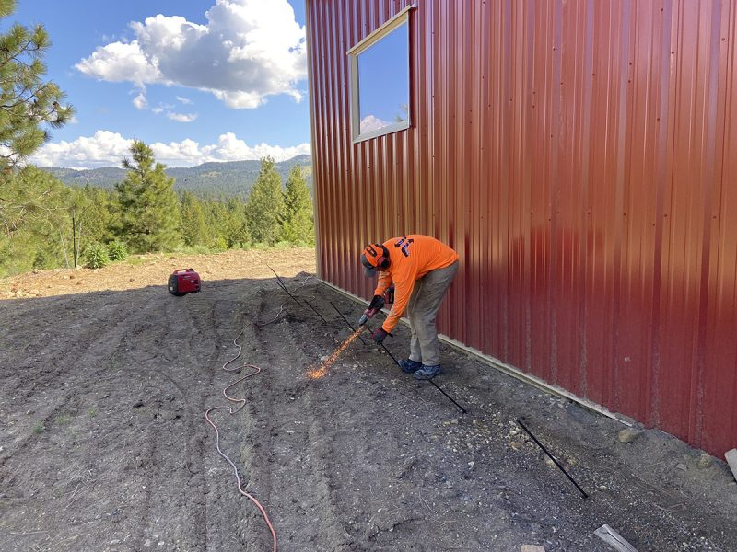
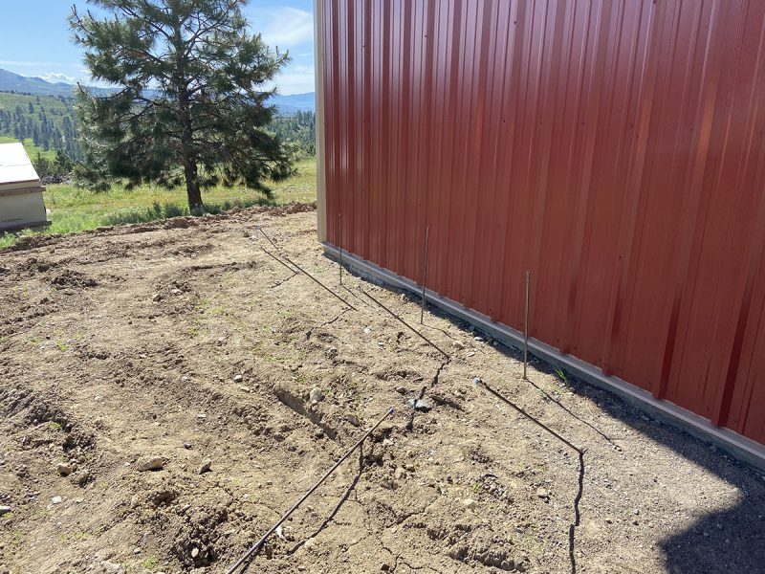
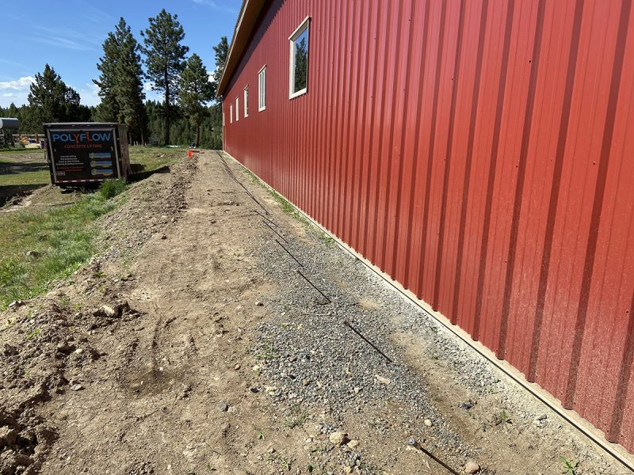
Shop Foundation Reinforcement
Near Ontario, Oregon • Soil Stabilization
PROBLEM
PROJECT PHOTOS
The 90'W × 120'L × 18'H shop sits on an old horse arena at approximately 4,300 feet in a high-snowfall area. Its foundation footing is 24 inches wide by 24 inches deep. The owner was concerned that the footing was too small and shallow for the location's snow load and winter conditions. One year after completion, the foundation and concrete slab showed settlement and movement.
Worker using an injection rod beside the shop foundation
SOLUTION
Polyflows’ penetrometer testing at 10 locations around the structure identified stable strata. Direct injection of two-component structural polyurethane foam built a structural footing from that strata to the bottom of the existing footing. More than 125 injection sites, including areas beneath 26 support posts, improved the soil's load-bearing capacity and stabilized the structure for its useful life.
Injection rods laid along the shop foundation perimeter
RESULT
The shop now has an enlarged footing footprint to increase the load bearing capacity in the soils under the original smaller footing. Our polyurethane foam also adds to the depth of the frost level to prevent damage caused during freeze/thaw cycles.
Shop foundation perimeter with staged injection equipment
208-780-9292 • gopolyflow.com
POLYFLOW | CASE STUDY

