Slide 1

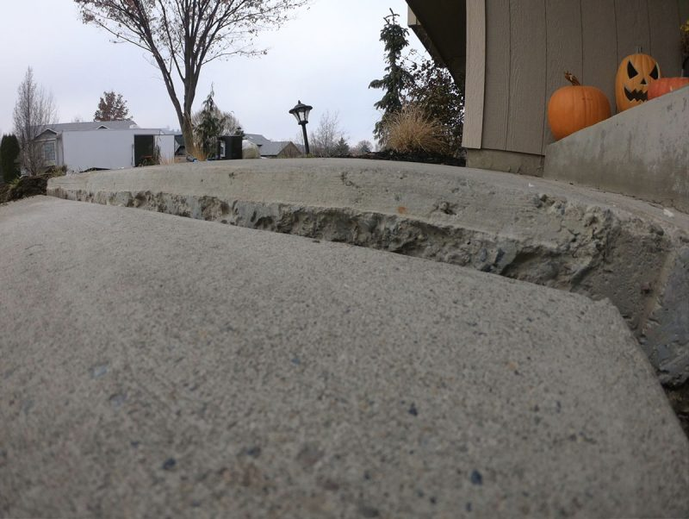
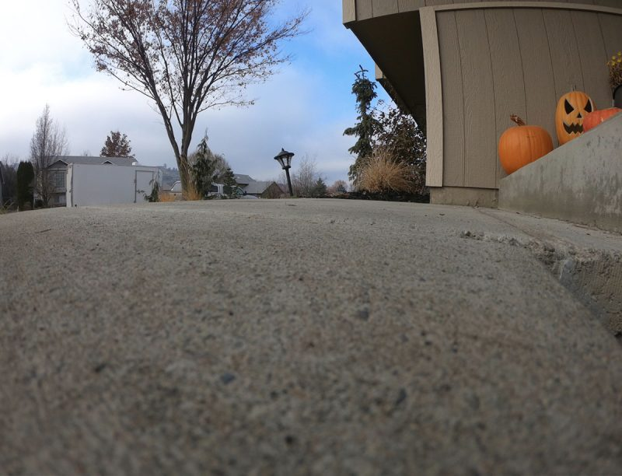
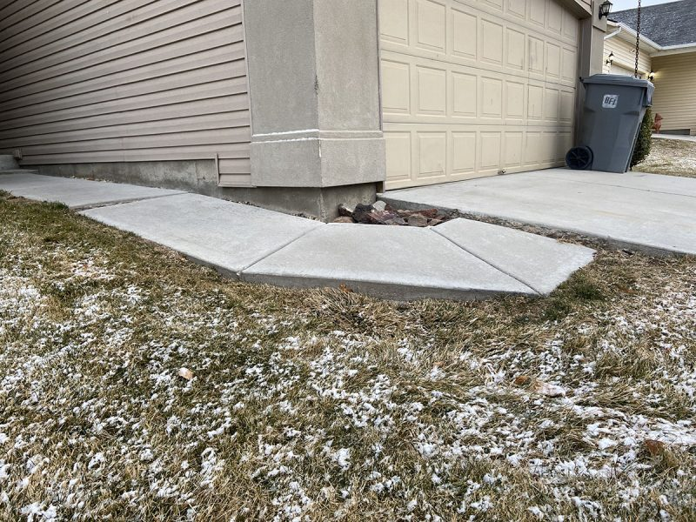
Sidewalk Case Study Compilation
Treasure Valley and surrounding locations, Idaho • Concrete Lifting
PROBLEM
PROJECT PHOTOS
Normal Sidewalk Settling Causes:
The number one cause for sidewalks to settle in our area are rain gutters being installed on the high side of the sidewalk. As rain drains on the high side it erodes the sub base away until the weight of the sidewalk settles into the earth.
The second most common reason is simply a lack of compaction during the construction/concrete installation process. As homes are built and they are backfilling against the foundation they don't always spend the time to compact in "lifts". Compacting in "lifts" means adding a little fill at a time and then compacting it before adding more.
Finally, the third reason is decomposition of organic matter. As organic matter decomposes it leaves voids that will eventually cause settlement.
settled residential sidewalk panels (image 1)
SOLUTION
During our pre inspection we do all we can to determine the cause so that we can first address correcting that issue before moving forward with our lifting process. Not always, but often the issue is deep in the soil so we start deep so we have a good foundation to lift off of. Sidewalks can often be tricky to lift because they twist one way or the other so we have proprietary methods and proprietary tools that assist in our success.
settled residential sidewalk panels (image 2)
RESULT
Once a sidewalk has been lifted and leveled the trip hazards are no longer a concern to friends, family and neighbors. By treating the deep cause of settlement the lift will last for many years to come.
settled residential sidewalk panels (image 3)
208-780-9292 • gopolyflow.com
POLYFLOW | CASE STUDY

