Slide 1

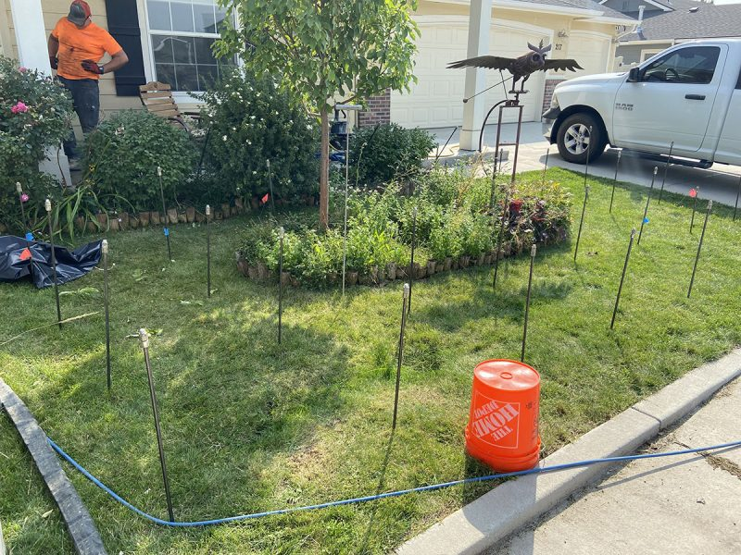
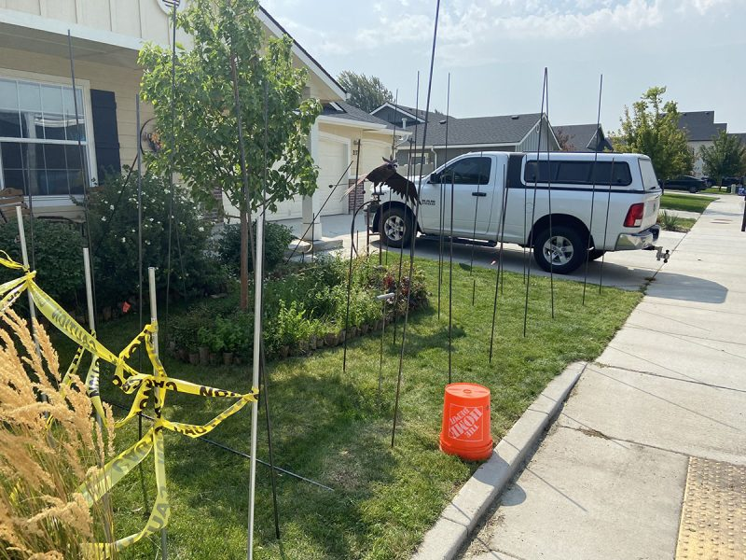
Sink Front Yard
Kuna, Idaho • Soil Stabilization
PROBLEM
PROJECT PHOTOS
The homeowners front yard and front porch began to show holes and visual signs of settling and movement from their original finished grades and heights. During our initial on-site inspection some of the depressions were tested with a simple soil hand probe to a depth of approximately 5 feet. In the hand probed depressions there was very loose soils discovered that warranted further geotechnical exploratory testing. Dynamic cone penetrometer testing was performed which revealed that there was unconsolidated loose soils to depths up to 13 feet deep.
SOLUTION
We worked with a local Geotechnical engineer and the developer to determine the possible causes. The dynamic cone penetrometer testing data was used to write up an effective mitigation recommendation that would provide the homeowner with a permanent solution to their soil problem before further damage was incurred to their property. We then strategically performed direct injection of a two-part structural foam to fill and consolidate the loose soils through out the yard and under the footing/foundation of the house. We also performed direct injection under the front porch to stabilize the soil and increase it's load bearing capacity; we then lifted the front porch back to its original grade and height. As an added value to the homeowner, we noticed there was a small part of the driveway that had settled so we lifted it as well. This process had very minimal impact on the landscape and was completed in 1 day.
front-yard soil-stabilization work area (image 1)
RESULT
The front yard will no longer have a sinking lawn and flower beds as well as the corner of the house will not experience differential settlement in the future.
front-yard soil-stabilization work area (image 2)
208-780-9292 • gopolyflow.com
POLYFLOW | CASE STUDY

