Slide 1

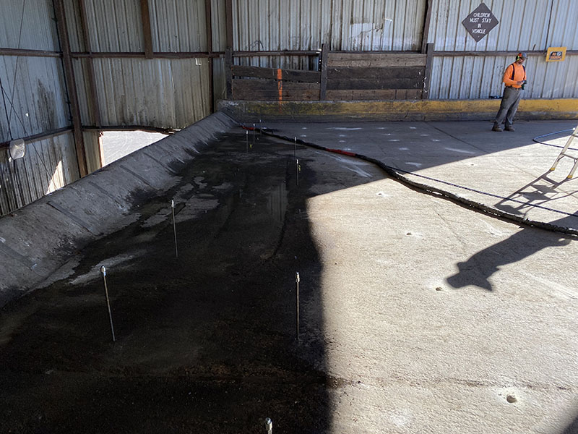
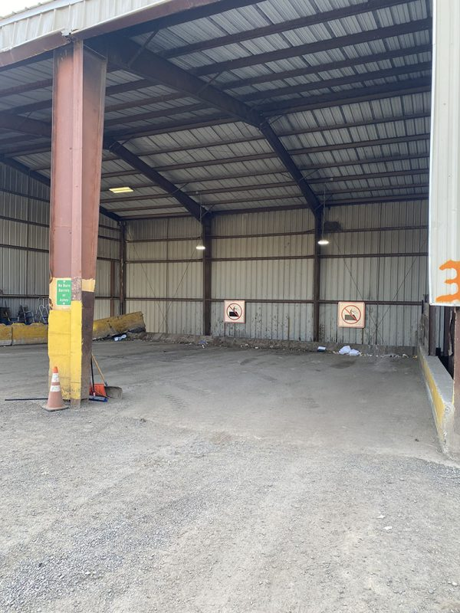

Transfer Station Concrete Lift and Deep Soil Stabilization
Weiser, Idaho • Concrete Lifting
PROBLEM
PROJECT PHOTOS
The transfer station is a place that rural dump trucks take the waste and dump it into an open concrete area then from that open area it gets pushed into trucks that transfer it to an offsite landfill. This particular transfer station had issues where the concrete pad was settling and when they washed it the water would run through the cracks and joints in the concrete but never come out anywhere. In our inspection process we drilled inspection holes and probed the soil and found that there were large voids through out the area.
SOLUTION
transfer-station concrete pad and injection layout (image 1)
After normal business hours we arrived with two crews and two separate trucks to get this job done in a timely manner so that they would be ready for their normal work schedule the next day. First, we drilled entry holes through the 8-inch-thick concrete so that we could install our injection rods in a grid pattern to cover the entire area. We used a two-part structural foam to fill the voids and stabilize eroded and loose soils as well as to lift the concrete. Some injection sites we went as deep as 12 feet to fill the void. Some areas took more material than others. During a process like this we use special meters to detect movement as well as two-man crews on each truck so that we can watch the gauges in the truck to determine the amount of material needed.
transfer-station concrete pad and injection layout (image 2)
RESULT
We filled all of the voids as well as lifted the 8-inch-thick panels back to their original grade and height. Our material is 90% strength in 15 minutes so by morning it was all the way cured and ready for the normal use of the heavy equipment used daily at the transfer station.
transfer-station concrete pad and injection layout (image 3)
208-780-9292 • gopolyflow.com
POLYFLOW | CASE STUDY

