Slide 1

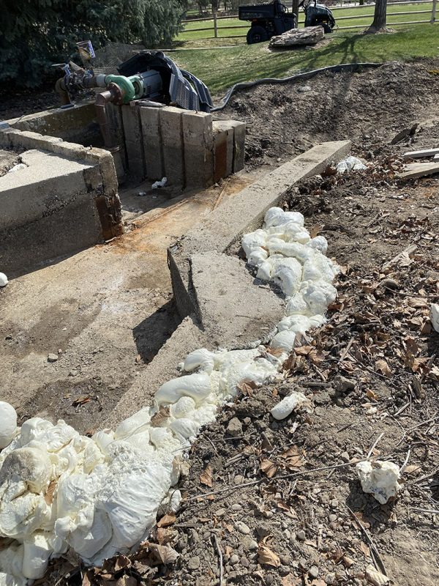
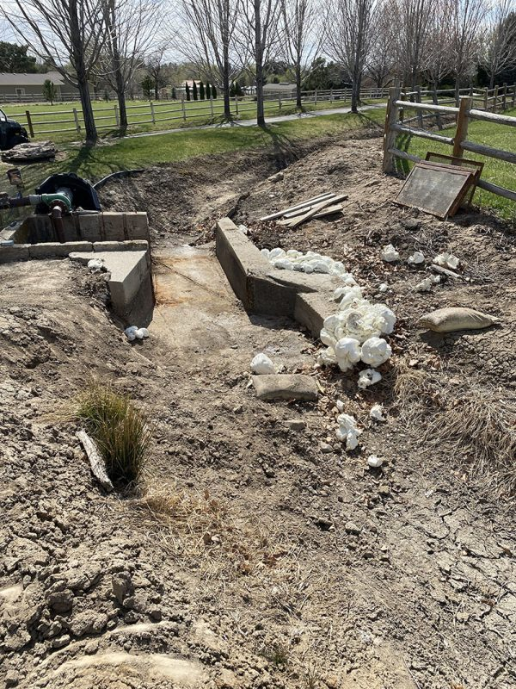
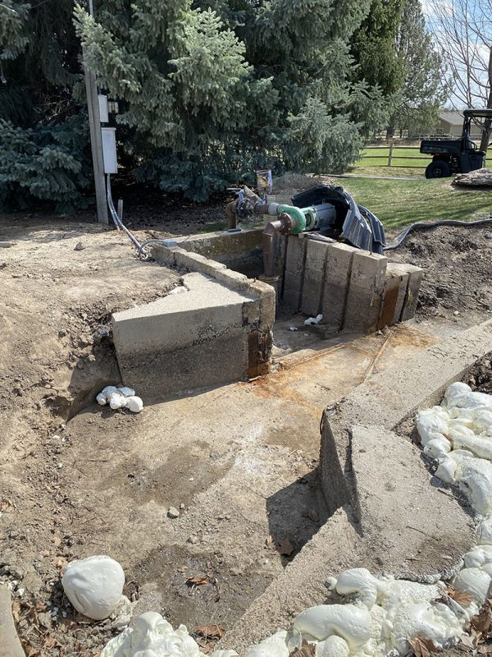
Washout void fill
Eagle, Idaho • Soil Stabilization
PROBLEM
PROJECT PHOTOS
An HOA was losing large amounts of water under and around the weir. The condition of the concrete was sound but the surrounding fill was washed out.
SOLUTION
weir-area washout and void-fill work (image 1)
We started the project by direct injection deep in the soil around the sides where the erosion had occurred; then we drilled through the concrete to fill all the voids that had been created under the concrete slabs.
weir-area washout and void-fill work (image 2)
RESULT
Water now flows through the weir and not under or around it.
weir-area washout and void-fill work (image 3)
208-780-9292 • gopolyflow.com
POLYFLOW | CASE STUDY

